Slide 1




Computer Networks
OSI Network Layer
Lecturer: Sura F. Ismail
Lecture Eight
Second Class.
Time: 8: 30- 10:30
Department: Informatics Systems Management (ISM)

Slide 2

Outline
Outline
Routing: How Data Packets Are Handled
Routing Processes: How Routes Are Learned

Slide 3
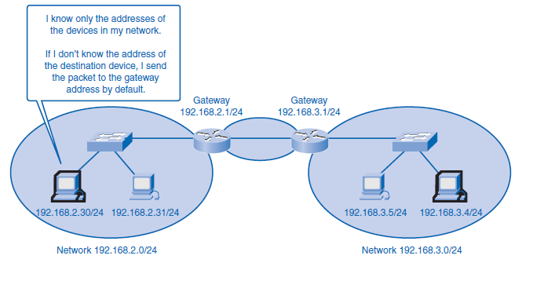
1. Routing: How Data Packets Are Handled
Outline
Communication within a network, or subnet, happens without a network layer device. When a host communicates outside the local network, a router acts as a gateway and performs the network layer function of choosing a path for the packet.
Device Parameters: Supporting Communication Outside the Network
As a part of its configuration, a host has a default gateway address defined. The gateway address is the address of a router interface that is connected to the same network as the host. The router interface is actually a host on the local network, so the host IP address and the default gateway address must be on the same network.

Slide 4
1. Routing: How Data Packets Are Handled
Outline
IP Packets: Carrying Data End to End
The role of the network layer is to transfer data from the host that originates the data to the host that uses it. During encapsulation at the source host, an IP packet is constructed at Layer 3 to transport the Layer 4 PDU. If the destination host is in the same network as the source host, the packet is delivered between the two hosts on the local media without the need for a router. However, if the destination host and source host are not in the same network, the packet can be carrying a transport layer PDU across many networks and through many routers. As it does, the information contained within is not altered by any routers when forwarding decisions are made.
At each hop, the forwarding decisions are based on the information in the IP packet header. The packet with its network layer encapsulation also is basically intact throughout the complete process, from the source host to the destination host. If communication is between hosts in different networks, the local network delivers the packet from the source to its gateway router. The router examines the network portion of the packet destination address and forwards the packet to the appropriate interface. If the destination network is directly connected to this router, the packet is forwarded directly to that host. If the destination network is not directly connected, the packet is forwarded to a second router that is the next-hop router. The packet forwarding then becomes the responsibility of this second router. Many routers or hops along the way can process the packet before reaching the destination.

Slide 5
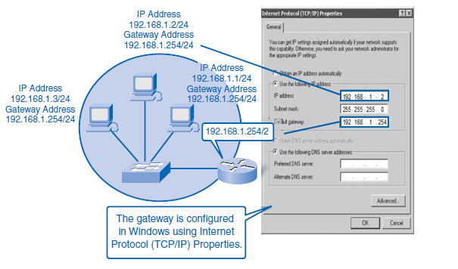
1. Routing: How Data Packets Are Handled
Outline
Gateway: The Way Out of the Network
The gateway, also known as the default gateway, is needed to send a packet out of the local network. If the network portion of the destination address of the packet is different from the network of the originating host, the packet has to be routed outside the original network. To do this, the packet is sent to the gateway. This gateway is a router interface connected to the local network. The gateway interface has a network layer address that matches the network address of the hosts. The hosts are configured to recognize that address as the gateway.
The default gateway is configured on a host. On a Windows computer, the Internet Protocol (TCP/IP) Properties tools are used to enter the default gateway IPv4 address. Both the host IPv4 address and the gateway address must have the same network (and subnet, if used) portion of their respective addresses.

Slide 6
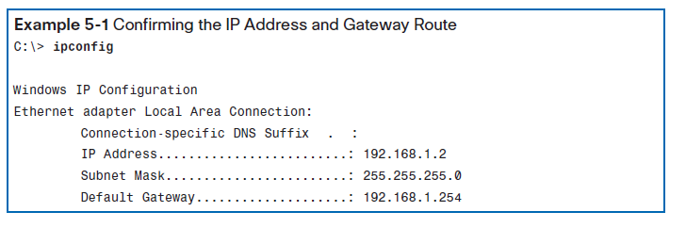
1. Routing: How Data Packets Are Handled
Outline
Confirming the Gateway and Route
An easy way to check the host IP address and default gateway is by issuing the ipconfig command at the command-line prompt of a Windows XP computer:

Slide 7
1. Routing: How Data Packets Are Handled
Outline
Route: A Path to a Network
A route for packets for remote destinations is added using the default gateway address as the next hop. Although it is not usually done, a host can also have routes manually added through configurations. Like end devices, routers also add routes for the connected networks to their routing table. When a router interface is configured with an IP address and subnet mask, the interface becomes part of that network. The routing table now includes that network as a directly connected network. All other routes, however, must be configured or acquired through a routing protocol. To forward a packet, the router must know where to send it. This information is available as routes in a routing table. The routing table stores information about connected and remote networks. Connected networks are directly attached to one of the router interfaces. These interfaces are the gateways for the hosts on different local networks. Remote networks are networks that are not directly connected to the router. Routes to these networks can be manually configured on the router by the network administrator or learned automatically using dynamic routing protocols. Routes in a routing table have three main features:
Destination network
Next-hop
Metric

Slide 8
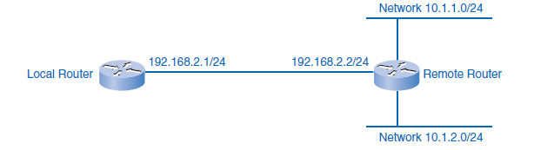
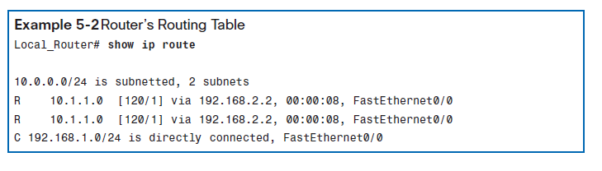
1. Routing: How Data Packets Are Handled
Outline
The router matches the destination address in the packet header with the destination network of a route in the routing table and forwards the packet to the next-hop router specified by that route. If there are two or more possible routes to the same destination, the metric is used to decide which route appears on the routing table.

Slide 9
1. Routing: How Data Packets Are Handled
Outline
As you know, packets cannot be forwarded by the router without a route. If a route representing the destination network is not on the routing table, the packet will be dropped (that is, not forwarded). The matching route could be either a connected route or a route to a remote network. The router can also use a default route to forward the packet. The default route is used when the destination network is not represented by any other route in the routing table.
Host Routing Table
Hosts require a local routing table to ensure that network layer packets are directed to the correct destination network. Unlike the routing table in a router, which contains both local and remote routes, the local table of the host typically contains its direct connection or connections (hosts can belong to more than one local network) and its own default route to the gateway. Configuring the default gateway address on the host creates the local default route. Without a default gateway or route, packets destined outside the network will be dropped. The routing table of a computer host can be examined at the Windows command line by issuing the netstat –r or the route print command.

Slide 10
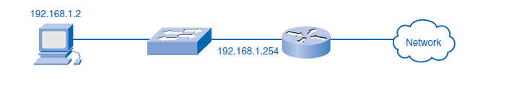
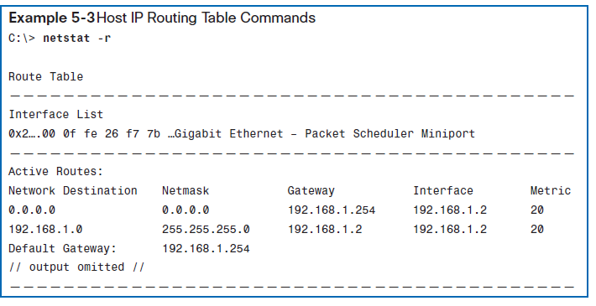
1. Routing: How Data Packets Are Handled
Outline

Slide 11
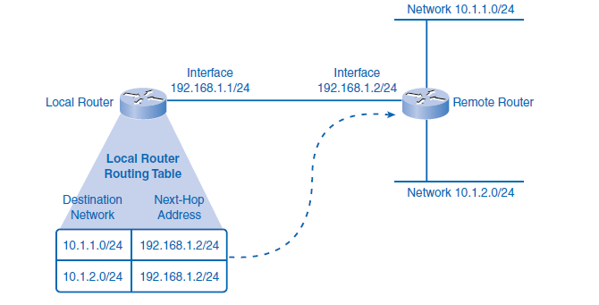
1. Routing: How Data Packets Are Handled
Outline
Routing
Routing is the process a router performs when making forwarding decisions for each packet arriving at the gateway interface. To forward a packet to a destination network, the router requires a route to that network. If a route to a destination network does not exist on the router, the packet will be forwarded to a default gateway. If no default gateway is configured, the packet cannot be forwarded. The destination network can be a number of routers or hops away from the gateway. If the router has an entry for the network in its routing table, it would only indicate the next-hop router to which the packet is to be forwarded, not the exact route to the final router. The routing process uses a routing table to map the destination network address to the next hop and then forwards the packet to this next-hop address.

Slide 12
1. Routing: How Data Packets Are Handled
Outline
Destination Network
For a router to route a packet to a destination network efficiently, it needs information about the route in its routing table. With millions of routes on the Internet, however, it is not reasonable to expect every route to be known to the router. The following sections describe how routers use information in routing tables and how packets can be forwarded when no information about routes can be found.
Routing Table Entries
The route, or destination network, in a routing table entry represents a range of host addresses and sometimes a range of network and host addresses. The hierarchical nature of Layer 3 addressing means that one route entry can refer to a large general network and another entry can refer to a subnet of that same network. When forwarding a packet, the router will select the most specific route that it knows. If a specific subnet is not in the routing table but the larger network that holds the subnet is known, the router will send it to the larger network, trusting that another router will find the subnet.

Slide 13
1. Routing: How Data Packets Are Handled
Outline
Packet Forwarding: Moving the Packet Toward Its Destination
Routing is performed packet by packet and hop by hop. Each packet is treated independently by each router along the path. At each hop, the router examines the destination IP address for each packet and then checks the routing table for forwarding information. The router will then do one of the following with the packet:
Forward it to the next-hop router
Forward it to the destination host
Drop it

Slide 14
1. Routing: How Data Packets Are Handled
Outline
A router takes the following steps to determine the appropriate action:
1. As an intermediary device, a router processes the packet at the network layer. However, packets that arrive at a router’s interfaces are encapsulated as a data link layer (Layer 2) PDU. The router first discards the Layer 2 encapsulation so that the IP packet can be examined.
2. The router examines the IP address.
3. The router checks the routing table for a match.
4. The router selects the next hop. In the router, the destination address in a packet header is examined. If a matching route in the routing table shows that the destination network is directly connected to the router, the packet is forwarded to the interface to which that network is connected.

Slide 15
1. Routing: How Data Packets Are Handled
Outline
5. The router then does one of the following:
■ Scenario A: The router forwards the packet. If the route matching the destination network of the packet is a remote network, the packet is forwarded to the indicated interface, encapsulated by the Layer 2 protocol, and sent to the next hop address. If the destination network is on a directly connected network, the packet has to be first re-encapsulated by the Layer 2 protocol and then forwarded out the proper interface to the local network.
■ Scenario B: The router uses the default route. If the routing table does not contain a more specific route entry for an arriving packet, the packet is forwarded to the interface indicated by a default route, if one exists. At this interface, the packet is encapsulated by the Layer 2 protocol and sent to the next-hop router. The default route is also known as the gateway of last resort.
■ Scenario C: The router drops the packet. If a packet is dropped, IP, by design, has no provision to return a packet to the sender or previous router. Such a function would detract from the protocol’s efficiency and low overhead. Other protocols are used to report such errors.

Slide 16
2. Routing Processes: How Routes Are Learned
Outline
Routers need information about other networks to build a reliable routing table. Networks and routes are constantly changing, with new networks coming on and routes going down. If a router has bad information about routes, it is likely it will forward packets incorrectly, causing packets to be delayed or dropped. It is vital that routers have current information about neighboring routers to reliably forward packets. The two ways in which a router can learn information about routes is through static routing and dynamic routing. The following sections also introduce common routing protocols used by routers to dynamically share information.

Slide 17
2. Routing Processes: How Routes Are Learned
Outline
Static Routing
The route information can be manually configured on the router, creating what is known as a static route. An example of a static route is a default route. Static routing requires a network administrator for initial setup and for any changes to routes. Static routes are considered very reliable, and the router does not use much overhead to process packets. On the other hand, static routes do not update automatically and have higher continuing administrative costs.
If the router is connected to a number of other routers, knowledge of the internetworking structure is required. To ensure that the packets are routed to use the best possible next
Dynamic Routing
Routers can also learn about routes automatically from other routers in the same internetwork, which is known as dynamic routing. Dynamic routing updates arrive from other routers and are used by the receiving router without administrative configuration. Dynamic routing has higher router processing overhead but little administrative cost after initial setup. If dynamic routing is not enabled and configured on a router, static routes to the next hops must be in place for the router to know where to forward packets.

Slide 18
2. Routing Processes: How Routes Are Learned
Outline
Routing Protocols
It is imperative that all routers in an internetwork have up-to-date and extensive route knowledge. Maintaining the routing table by manual static configuration is not always feasible. Configuring one of several available dynamic routing protocols on network routers is a much more efficient way to keep the routers updated.
Routing protocols are the set of rules by which routers dynamically share their routing information. As routers become aware of changes to the networks for which they act as the gateway, or changes to links between other routers, the information is passed on to other routers. When a router receives information about new or changed routes, it updates its own routing table and, in turn, passes the information to other routers. In this way, all routers have accurate routing tables that are updated dynamically and can learn about routes to remote networks that are many hops away. An example of routers sharing routes is shown in Figure 6.
The most common routing protocols
Routing Information Protocol (RIP)
Enhanced Interior Gateway Protocol (EIGRP)
Open Shortest Path First (OSPF)

Slide 19
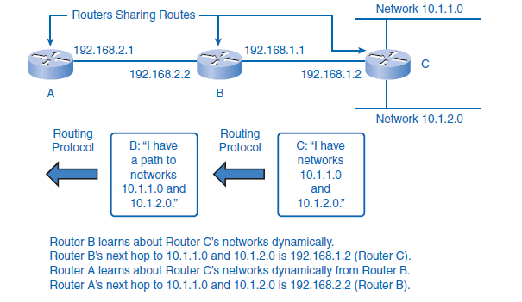
2. Routing Processes: How Routes Are Learned
Outline

Slide 20
2. Routing Processes: How Routes Are Learned
Outline
The advantage of routing protocols providing routers with up-to-date routing tables is tempered by added overhead costs. The exchange of route information adds overhead by consuming network bandwidth. This overhead can be an issue with low-bandwidth links between routers. Another cost is the router’s processing overhead. Not only does each packet need to be processed and routed, but updates from routing protocols also require complicated algorithmic calculations before the route information can be used in a routing table. This means that routers employing these protocols must have sufficient processing capacity to both implement the protocol’s algorithms and to perform timely packet routing and forwarding, which can add to initial network setup costs.
Static routing does not produce network overhead and places entries directly into the routing table with no route processing required by the router. The cost for static routing, as mentioned earlier, is administrative time taken to manually configure and maintain routing tables in a manner that ensures efficient routing. In most internetworks, a combination of static (including default) and dynamic routes is used to provide efficient routing.

Slide 21


THANK YOU

